Slide 1

Department of Computer Science and Engineering
PREDICTING SOLAR POWER GENERATION & SOLAR RADIATION USING SCI-KIT LEARN.
TEAM MEMBERS
G.KOUSHIK(113320104034)
D.JAGADEESAN(113320104040)
P.YASWANTH REDDY(113320104070)
GUIDE
Ms.SHANTHA SHEELA, Μ.Ε., Assistant Professor

Slide 2
Objective
The goal is to develop a machine learning model for solar power generation prediction, to potentially replace the updatable supervised machine Learning Classification models by predicting results in the form of best accuracy by comparing supervised algorithms.
Every grid operator has the same issue with their successful integration to meet current demand due to the intermittent nature and limited control over the solar condition. The grid operator now also has to forecast the availability of solar and solar generation facilities in the upcoming hour, day, or week in addition to needing to forecast demand and balance it with supply.

Slide 3
Abstract
The solar energy sector faces significant challenges in site selection, risk assessment, and decision support, resulting in suboptimal outcomes and financial losses. Traditional approaches, marked by static methodologies, have proven inadequate in adapting to dynamic environmental conditions. To revolutionize decision-making in solar power projects, this project introduces an innovative and adaptive system for site selection and risk assessment.
In response to the pressing challenges faced by the solar energy sector, this project advocates for a transformative shift in decision-making methodologies. The existing paradigm, marked by static and limited approaches to site selection, risk assessment, and decision support, has shown its shortcomings through financial losses and operational inefficiencies.
Recognizing the need for a more adaptive and data-driven solution, this project endeavors to introduce an innovative framework that redefines the landscape of solar power project planning.

Slide 4
Problem Statement
The current landscape of solar energy projects faces challenges in optimal site selection, risk assessment, and decision-making, leading to financial losses and suboptimal energy production. Existing systems often lack adaptability to changing environmental conditions, neglect critical risk factors, and fall short in providing comprehensive decision support.
Critical risk factors, such as extreme weather events, regulatory changes, and supply chain disruptions, often go unnoticed or are inadequately addressed in existing systems. This oversight leaves solar energy projects vulnerable to disruptions and hampers their long-term viability and sustainability.

Slide 5
Existing System
Bifacial photovoltaic modules are able to convert the solar radiation reaching their front and rear sides, which means that more electricity can be produced using the same array area as mono facial modules with similar ratings.
In some locations, the cost per power unit for such a technology has already become cost-competitive with conventional mono facial modules. The so-called effective irradiance and the bifacial gain are useful metrics, respectively, to assess the solar resource and the performance of bifacial arrays.
To calculate the effective irradiance, studies previously published employ rear-side irradiance measurements, whereas to compute the bifacial gain, other works make use of mono facial modules with a rating similar to those of the bifacial modules under analysis.
In this article, a straightforward method is presented, allowing us to calculate the effective irradiance from the maximum power current and to calculate the bifacial gain using a power scaling relation.

Slide 6
Disadvantages
They collect only solar array panel data for analysis purpose.
They didn't do any machine learning techniques.
They analyze only power radiation.
Their working terminologies are quite complex to understand.
They did not deploy the model into environment.

Slide 7
Proposed System
Solar radiation is the Earth’s primary source of energy and has an important role in the surface radiation balance, hydrological cycles, and vegetation photosynthesis, and weather and climate extremes.
The accurate prediction of solar radiation is therefore very important in both the solar industry and climate research. Sci-kit-learn is a popular machine learning library in Python, but it primarily focuses on traditional machine learning algorithms and directly provide functionality for solar power generation or solar radiation prediction.
However, you can use sci-kit-learn in conjunction with other libraries and techniques to build models for solar power generation and solar radiation prediction Gather historical solar power generation data and solar radiation data from reliable sources.
Make sure the data includes relevant features such as time of day, weather conditions, temperature, humidity, and any other factors that might affect solar power generation or solar radiation. The proposed system, with its focus on site selection, risk assessment, and dynamic learning, aims to provide more accurate and adaptive recommendations.
The inclusion of advanced machine learning techniques, online learning, and dynamic site selection could potentially improve accuracy, especially in scenarios with changing environmental conditions.

Slide 8
Advantages
We compared more than a two algorithms to getting better accuracy level.
We figured out solar power generation & radiation.
We deploy the model into production level application.
We improved the accuracy level and performance level.
We implement machine learning techniques for effective manner.

Slide 9
Literature Review
TITLE: A Review Paper on Electricity Generation from Solar Energy
AUTHOR: Mohd Rizwan Sirajuddin Shaikh 1 , Santosh B. Waghmare 2 , Suvarna Shankar Labade 3 , Pooja Vittal Fuke4 , Anil Tekale5 1, 2,3,4,5 Students, Department of Electrical Engineering, Savitribai Phule Pune University
YEAR: 2022
the Solar Energy is produced by the Sunlight is a non-vanishing renewable source of energy which is free from eco-friendly. Every hour enough sunlight energy reaches the earth to meet the world’s energy demand for a whole year. In today’s generation we needed Electricity every hour. This Solar Energy is generated by as per applications like industrial, commercial, and residential. It cans easily energy drawn from direct sunlight. So it is very efficiency & free environment pollution for surrounding. In this article, we have reviewed about the Solar Energy from Sunlight and discussed about their future trends and aspects. The article also tries to discussed working, solar panel types; emphasize the various applications and methods to promote the benefits of solar energy. Keywords: Renewable energy, Solar panel, Photovoltaic cell, Modelling of PV Panel, Solar Concrete Collector

Slide 10
Literature Review
TITLE: Solar energy potential assessment for electricity generation on the south-eastern coast of Iran
AUTHOR: Rahim Zahedi1, Erfan Sadeghitabar2, Abolfazl Ahmadi1*
YEAR: 2021
Among the types of renewable energy, solar energy has received more attention due to its ability to convert directly into electricity and heat, its ease of use, its possibility of storage, and its endlessness, so in recent decades, a lot of research has been done on solar energy systems in the world and in Iran. Considering Iran's potential in the field of solar energy and the country's need for this type of energy, it is necessary to locate and identify suitable sites for the use of solar energy. In this research, the potential of generating power from solar energy on the ocean coasts of south-eastern Iran has been investigated. Finally, the total power of electricity that can be extracted from suitable places in the region was calculated; results showed that 37.5% of the Makran area is exploitable as solar farms

Slide 11
Literature Review
TITLE: Photovoltaic Power Generation Forecasting for Regional Assessment Using Machine Learning
AUTHOR: Monica Borunda 1,* , Adrián Ramírez 2 , Raul Garduno 3 , Gerardo Ruíz 2 , Sergio Hernandez 2 and O. A. Jaramillo 4
YEAR: 2021
Solar energy currently plays a significant role in supplying clean and renewable electric energy worldwide. Harnessing solar energy through PV plants requires problems such as site selection to be solved, for which long-term solar resource assessment and photovoltaic energy forecasting are fundamental issues. This paper proposes a fast-track methodology to address these two critical requirements when exploring a vast area to locate, in a first approximation, potential sites to build PV plants. This methodology retrieves solar radiation and temperature data from free access databases for the arbitrary division of the region of interest into land cells. Data clustering and probability techniques were then used to obtain the mean daily solar radiation per month per cell, and cells are clustered by radiation level into regions with similar solar resources, mapped monthly.

Slide 12
Literature Review
TITLE: LITERATURE STUDY ON SOLAR ENERGY RESOURCES – A GEOGRAPHICAL ANALYSIS
AUTHOR: 1 Deepu B.P. 2Dr.H.Kamala
YEAR: 2022
With a population of 1.4 billion and one of the world’s fastest-growing major economies, India will be vital for the future of the global energy markets. The Government of India has made its impressive progress in recent years in attaining self-sufficiency in producing green energy through National Solar Energy Mission-2020. Report on India 2020 energy policy review states that India successfully implemented a range of energy market reforms and carried out a huge amount of renewable electricity deployment, notably in solar energy and other renewable including wind energy. It is recognized that India is one among the several countries of the world and has made huge strides to ensure full access to electricity, bringing power to more than 700 million people since 2000. By the end of 2030 India is planned to bring secure, affordable and sustainable energy to all its citizens so that India can make its significant progress in reducing the use of traditional biomass in cooking.

Slide 13
Literature Review
TITLE: REVIEW ON SOLAR ENERGY RESOURCES AND PV SYSTEM
AUTHOR: Amarjeet P.Ghadge1
YEAR: 2021
India is a fast developing country and in population we are nearer to China, In India there will be global future of the solar energy markets. Energy sources classify into renewable energy and nonrenewable energy sources due to hazardous effect on environment in recent years the Government of India is promoting the production of green energy through National Solar Energy Mission-2020. India 2020 energy policy reports states that India is implementing the use of solar energy for electricity generation with wind energy. It is considered that India is one of the countries in the world who ensure full access to electricity, bringing power to more than 700 million people since 2000. Now India is planning to reduce load on conventional power plant by using solar thermal system like photovoltaic system.

Slide 14
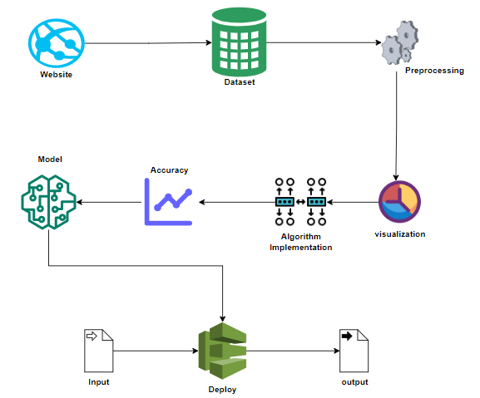
System Architecture
.

Slide 15
Block Diagram

Slide 16
List Of Modules
Data Pre-processing
Data Analysis of Visualization
Deployment

Slide 17
Module Description
Data Pre-processing:
Validation techniques in machine learning are used to get the error rate of the Machine Learning (ML) model, which can be considered as close to the true error rate of the dataset. If the data volume is large enough to be representative of the population, you may not need the validation techniques. However, in real-world scenarios, to work with samples of data that may not be a true representative of the population of given dataset. To finding the missing value, duplicate value and description of data type whether it is float variable or integer. The sample of data used to provide an unbiased evaluation of a model fit on the training dataset while tuning model hyper parameters.

Slide 18
Data Visualization
Data visualization is an important skill in applied statistics and machine learning. Statistics does indeed focus on quantitative descriptions and estimations of data. Data visualization provides an important suite of tools for gaining a qualitative understanding. This can be helpful when exploring and getting to know a dataset and can help with identifying patterns, corrupt data, outliers, and much more. With a little domain knowledge, data visualizations can be used to express and demonstrate key relationships in plots and charts that are more visceral and stakeholders than measures of association or significance. Data visualization and exploratory data analysis are whole fields themselves and it will recommend a deeper dive into some the books mentioned at the end.

Slide 19
Deployment
The Deployment module in the project involves implementing the developed framework into real-world scenarios of solar power project planning. This phase encompasses strategizing implementation, integrating the framework with existing systems, and conducting pilot tests to evaluate its performance. Additionally, it includes providing training and support to stakeholders, monitoring effectiveness through continuous evaluation, and ensuring scalability and sustainability for long-term use. Comprehensive documentation is essential throughout the deployment process. By effectively managing deployment, the project aims to contribute to more informed decision-making and improved outcomes in the solar energy sector.

Slide 20
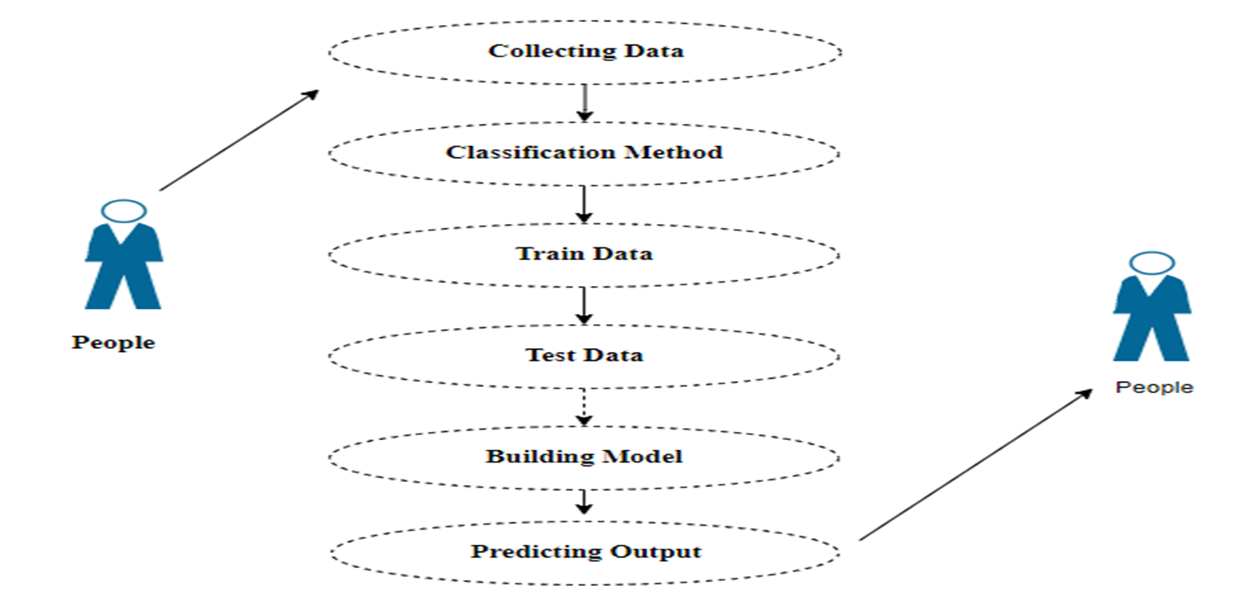
Use case diagram:

Slide 21
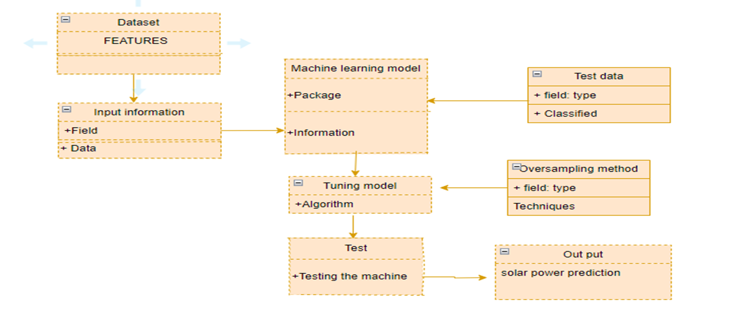
Class diagram:

Slide 22
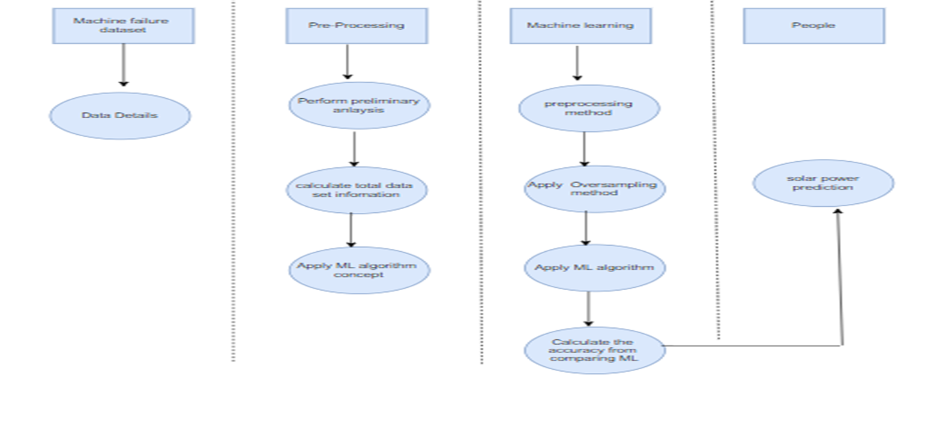
Activity diagram:

Slide 23
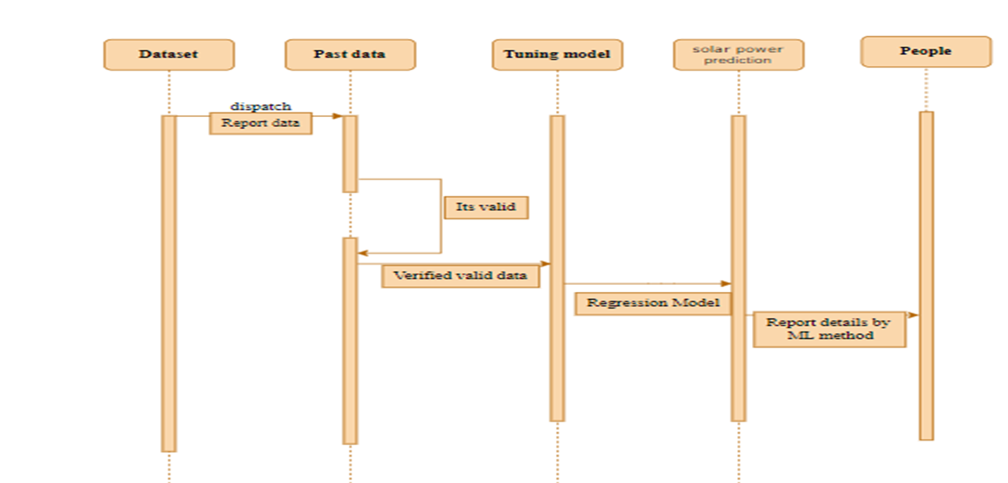
Sequence diagram:

Slide 24
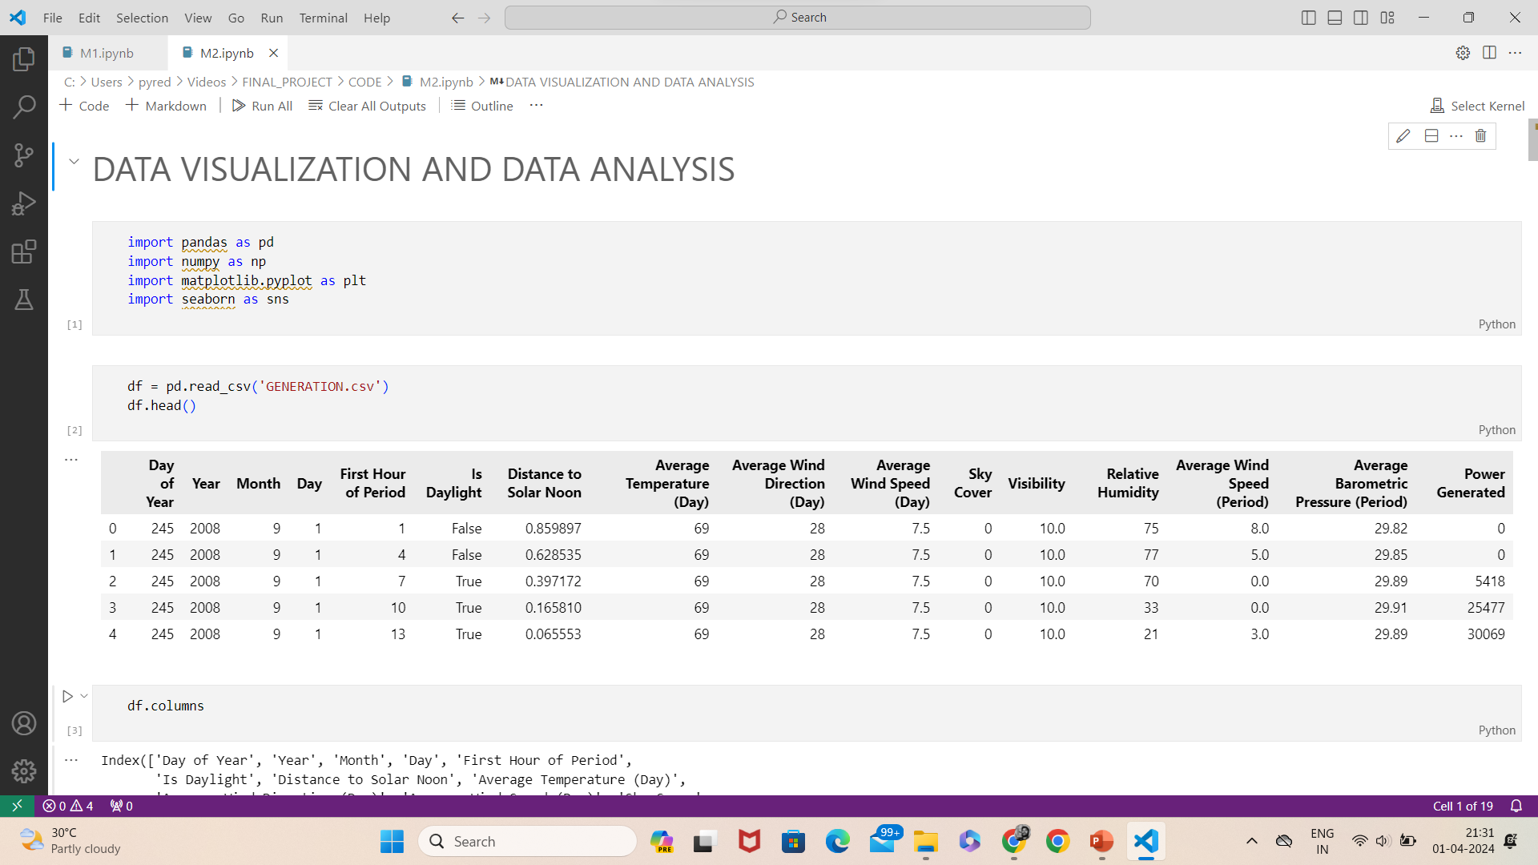
Sample Coding

Slide 25
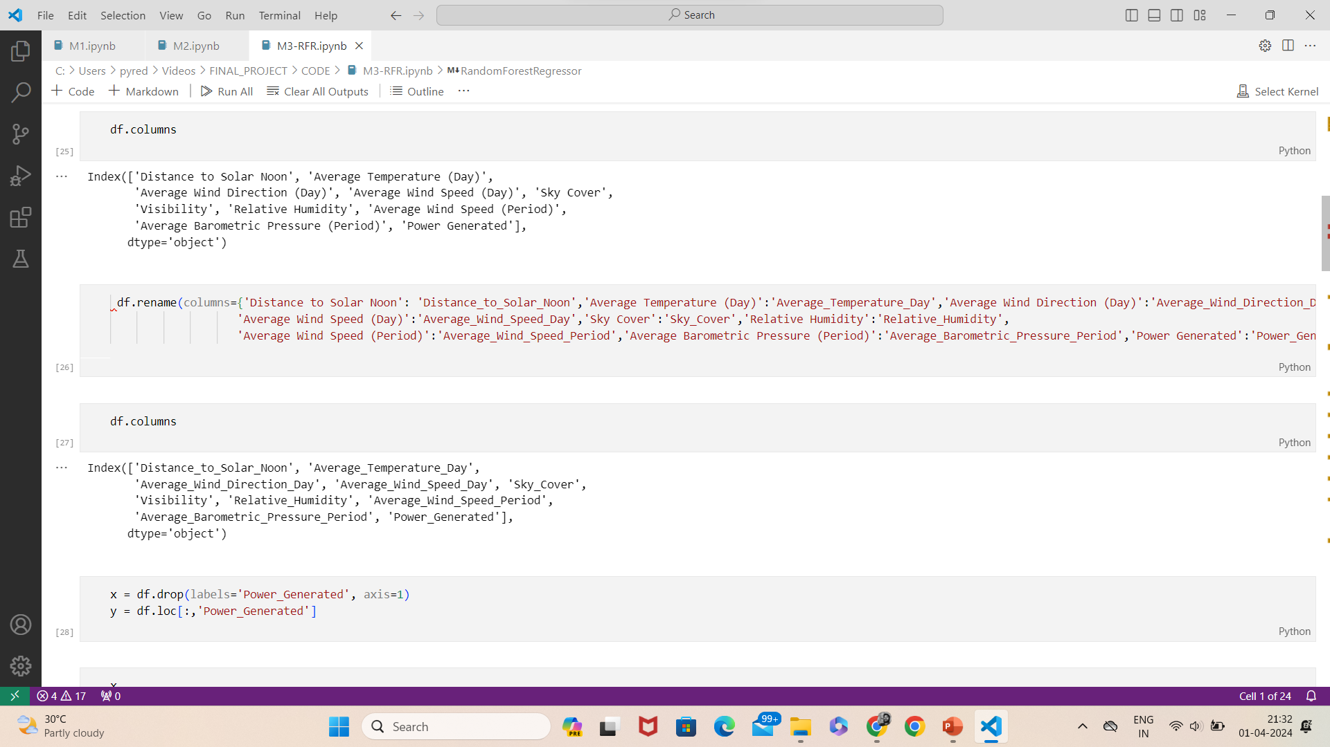

Slide 26
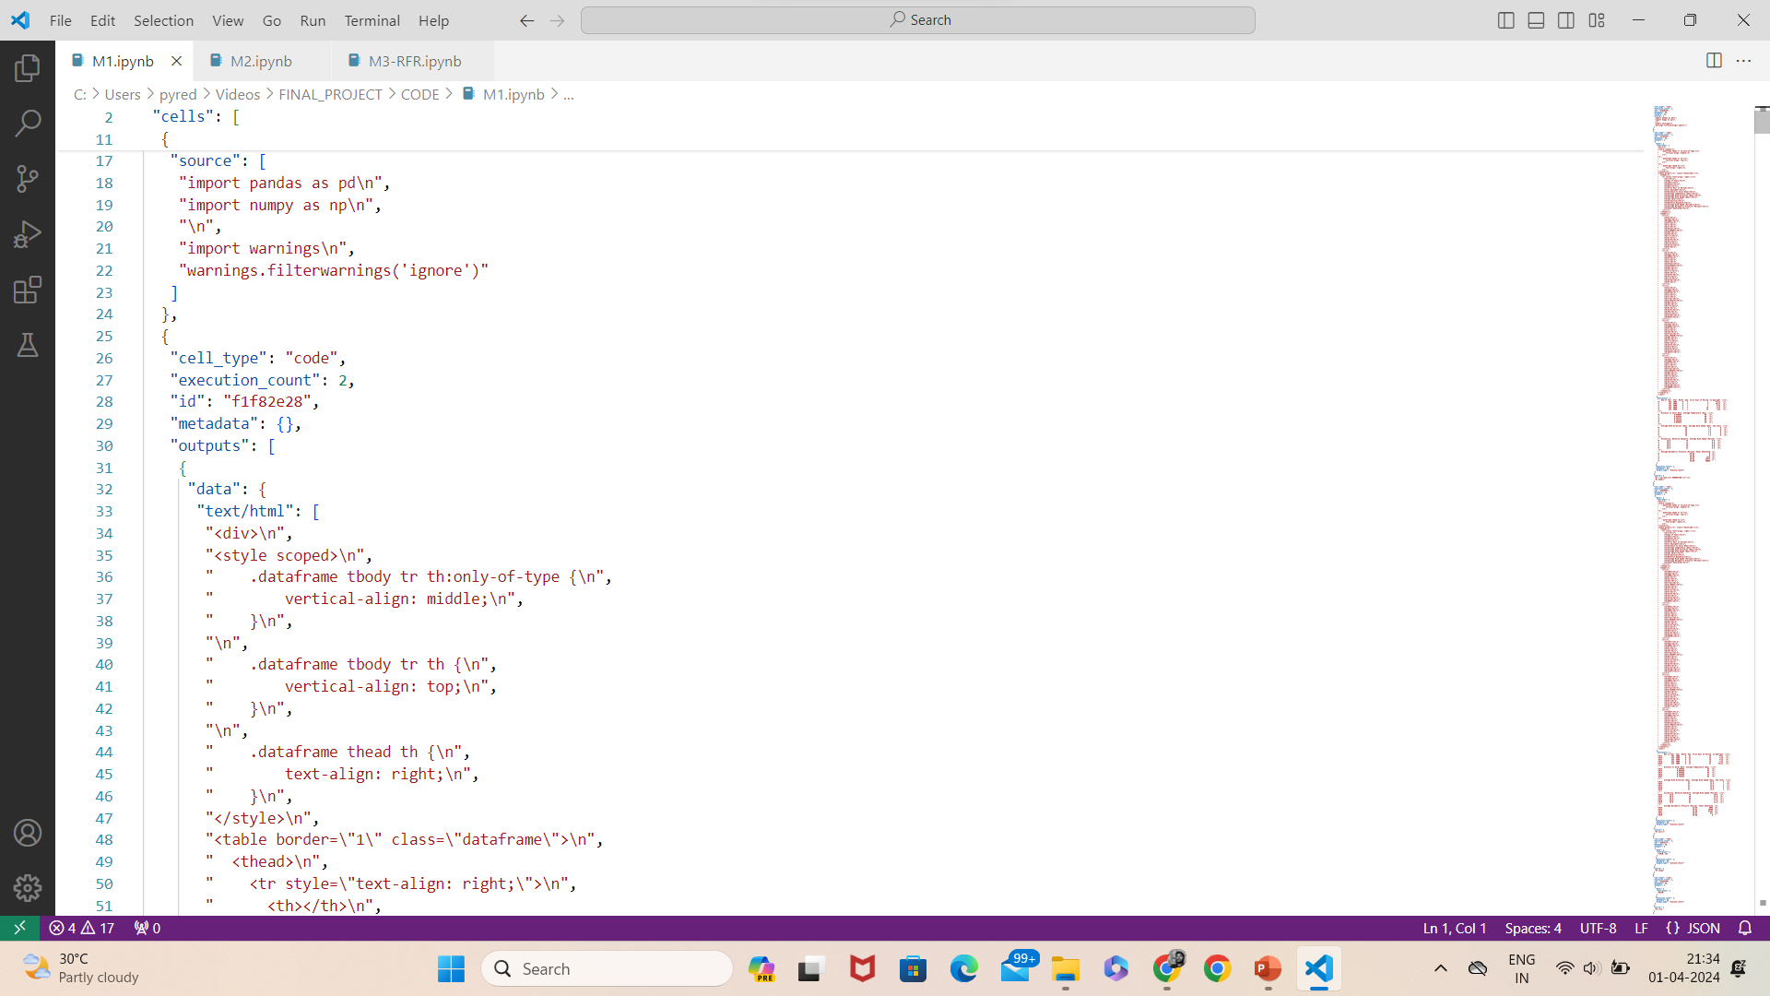

Slide 27
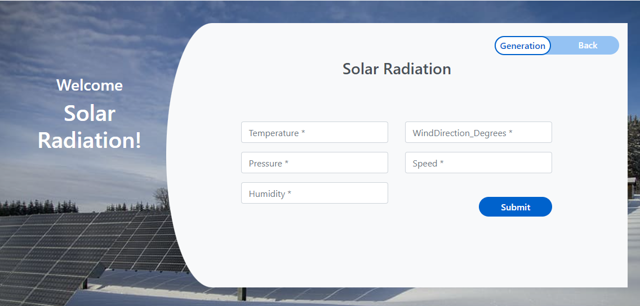
Output:

Slide 28
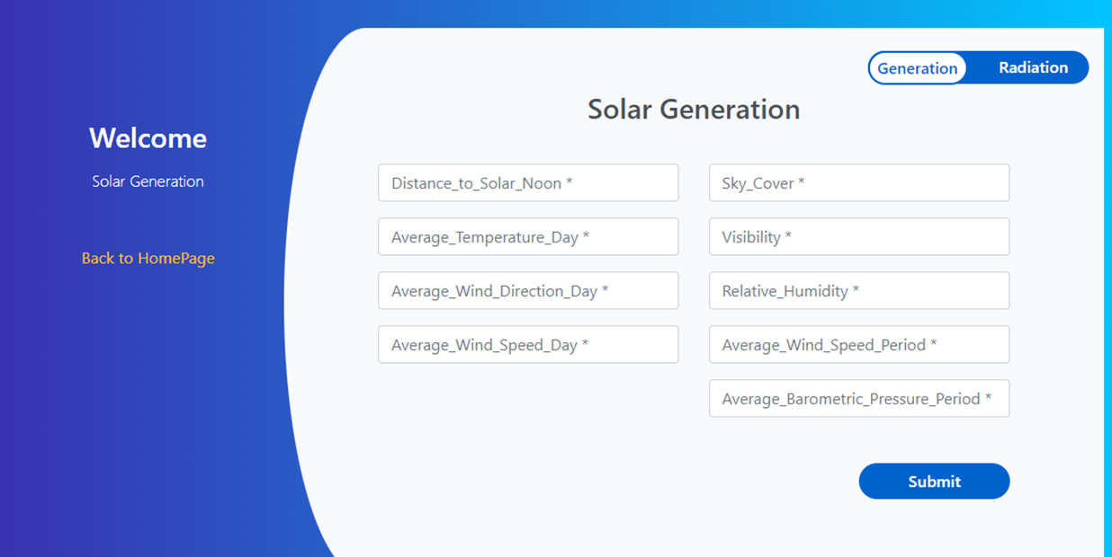

Slide 29
Environmental Requirements
1. Software Requirements:
Operating System : Windows 10 or later
Tool : Anaconda with Jupyter Notebook
Processor : Intel i3 or later
Hard disk : minimum 10 GB
RAM : minimum 4 GB
2. Hardware Requirements:
Arduino uno
Thermal sensor
Humidity sensor

Slide 30
Future Work
Wind Power Generation Prediction to connect the AI Model. By integrating wind power generation prediction into the existing AI model framework, the system will be able to provide more comprehensive insights and recommendations for energy optimization.
To Optimize the Work to implement in AI Environment. This may involve refining data processing pipelines, enhancing model training algorithms, and deploying efficient computational resources to support the increased computational demands.

Slide 31
Conclusion
The project presents a comprehensive framework aimed at revolutionizing decision-making processes within the solar energy sector. By addressing key challenges in site selection, risk assessment, and decision support, the project introduces innovative modules for data pre-processing, analysis, visualization, and deployment using arduino technology. Through the integration of these modules, the project offers a holistic approach to optimizing solar power project planning.

Slide 32
THANK YOU

